Slide 1
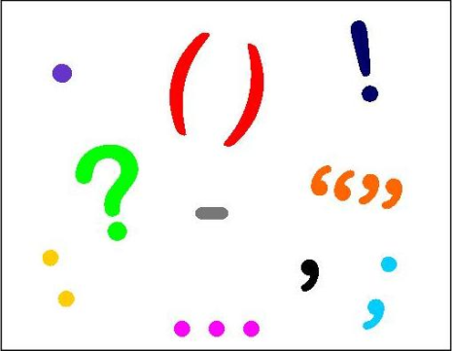
Punctuation
Walt: Add a range of punctuation into our writing
We will look at:
Commas ,
Inverted commas “
Apostrophes: omission (can’t) and possession (Will’s)
Contractions I have I’ve

Slide 2
Commas
When would we use commas?
Lists
Different phrases in a sentence
To add a ‘drop in clause’
Click this animation to reveal the answers!

Slide 3
Examples
Lets try these together:
List – For this experiment you will need a cup 50ml of vinegar some glitter and a flask.
Joining phrases – The sun feels so warm today I am worried about burning.
Drop in Clause – My book which was always scruffy he been lost by the teacher.

Slide 4
Write these in your book correctly
The items I need for football are socks shin pads shorts and a football shirt.
I hate carrots cabbage sprouts and peas but mum still make me eat them.
I love it when it rains it fills our yard with puddles.
The grumpy bald man on our street is always telling us to be quiet.
My teacher Mrs handbag is as old as my Granddad but she’s not as nice.

Slide 5
Inverted commas
What are inverted commas?
Commas that are used for irony:
He thought he was ‘special’.
They are mainly used for speech:
Sam said, “Is it home time yet?”
Click this animation to reveal the answers!

Slide 6
Try adding inverted commas to these:
The teacher told the children, put your books away.
The soldier told the children, we fought for your futures.
What time will he arrive? she asked.
That, he said, is nonsense.
If I throw this bag away she questioned, would it decompose?

Slide 7
Apostrophes
Possession:
Jacks gloop (singular)
Teachers worksheets (plural)
Omission:
Where does the apostrophe go ?
She is annoying Shes annoying

Slide 8
Try adding apostrophes
My brother is so annoying.
I have worked really hard on this.
The dancers costumes shimmered in the stage lights.
The camels humps were full of water.
Jacks so delighted that he has been accepted.
Can you pass me Adams coat?

Slide 9
Contractions
What other bit of punctuation is needed in a contraction?
could not I have was not
couldn’t I’ve wasn’t
Click this animation to reveal the answers!

Slide 10
Change the sentence to include a contraction:
I could not believe my brother, he was not supposed to climb up there.
I am sorry I was not able to come this weekend.
It would have been amazing if you were there.
I should have done my homework earlier.
She would not have done that even if you had given me your money.

