Slide 1
Writing a News Article (Report)

Slide 2
News Articles (Reports)
A news article is actually a type of recount.
When you think about where you find news articles/reports, you probably think about the news that you read in newspapers, the internet, magazines, hear on the
radio, and see on
television etc.

Slide 3
Main Purposes Of News Articles (Reports)
There are three main purposes of news articles:
To inform
To entertain
To persuade
A news article should contain objective, factual information and be written in the third person (he, she, it, they).
The text should be simple, clear and to the point.
The article should not be emotional and only rarely include an opinion.

Slide 4
The Outline Of a News Article (Report)
Most Important
Less Important
Least Important

Slide 5
The Structure Of a News Article
A news article usually consists of:
A headline
The Subhead (Optional)
A byline
A body

Slide 6
Generally, a narrative will build up to the climax, or the most important part, of the story. A news article, on the other hand, begins with the most important information and then proceeds to the less important information, leaving the least important to the end.
A news article begins with a lead paragraph that contains the most significant information in the story.

Slide 7
The Headline
The headline is the title of your news article.
It is a very brief summary of your news article.
The heading must grab the reader’s attention by using exciting words.
It can often contain just a noun and a verb.
All important words are capitalized and there is no punctuation at the end of the title.

Slide 8
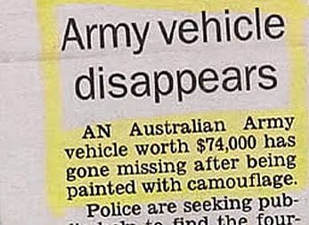
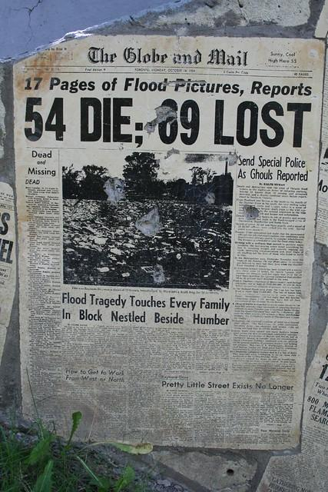
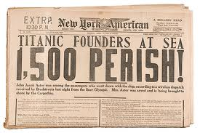
Headline Examples

Slide 9
The Subhead (Optional)
Sometimes a subhead, or secondary title, appears immediately after the headline.
A subhead provides additional information about the story.

Slide 10
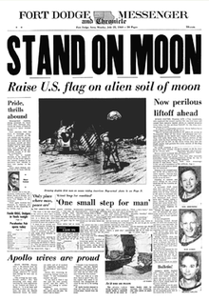
Subhead Examples

Slide 11
The Byline
The byline is positioned after the subhead or under the headline.
As the name suggests, it is the line that tells who the story is by; that is, who wrote the article.
Sometimes the date is put with the byline.

Slide 12
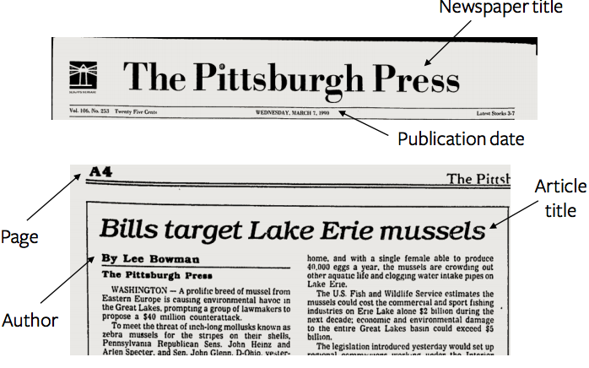
The Byline Examples

Slide 13
Example of Headline, Subhead and Byline.
HOUSES ROBBED
Ten houses robbed before man caught
By Jason Smith. March 18, 2019.

Slide 14
The Lead Paragraph
The beginning of a news article is called the lead, and it sets the structure for the rest of the article.
The most important ideas of the article are included in the lead.
A good lead usually answers the following questions:
Who?
What?
Where?
When?
Why?
How?

Slide 15
The 5Whs (+1) of the Lead Paragraph
Who: the subject of the article. The article could be about a person, place, idea, event or object – basically anything about which an article can be written.
What: the action of the article. What has happened or what is currently happening.
Where: the place the action is happening.
When: the time frame of the article. Did the action take place last night, last week, or over the course of a month?
Why: explains the “what,” or the actions that occurred.
How: describes the sequence of events or actions that occurred.

Slide 16
The Lead (First) Sentence
The first sentence of the lead, in particular, is very important.
It must hook readers and encourage them to continue reading.
In most news articles, the first sentence gives answers to as many of the 5 WHs as possible, in as few words as possible.
Eg: Thousands of students marched in the streets of London today to protest violence in schools.

Slide 17
The Lead (First) Sentence
To create an original and captivating first sentence you might consider introducing your topic using a lead that:
Asks a question/s
Includes a surprise/s
Creates suspense
Uses a quotation
Provokes a thought or idea

Slide 18
Lead Paragraph Example

Slide 19
The Middle Paragraphs
The middle paragraphs of a news article provide the reader with more details about the topic.
There should be smooth transitions from one paragraph to the next.
Remember to be objective – do not state opinions.
The purpose of an article is to convey facts.
Include a quotation/s from people involved in the story, and here the quotation/s can express opinions.
Make sure the speaker is properly identify.

Slide 20
Quotations
If the speaker has a title or a specific role in the event, draw attention to it.
For example:
“The kids wear clothes that look just like ours,” Tara Clarke, a participant in the ceremony, commented.
“We have just invested a great deal of money into this program,” said Norma Jacob, Minister of Education.
If the speaker has already been referred to at some point in the article, you may then refer to the speaker by their last name only.
For example:
“As much as I enjoyed the trip, I am happy to be home,” Clarke said.

Slide 21
The Last Paragraph
The last paragraph concludes and summarizes the article.
It may also provide a call to action – a suggestion of what readers can do in response to the article.
For example, the last paragraph of an article about an earthquake could include information about where readers could donate money, clothes, blankets etc to help those affected.

Slide 22
Example for Grade 6
INTERNET OUTAGE, KIDS GOING CRAZY
Government officials hope to rectify the situation soon
John Budiman. 18th July, 2019.
Social problems among children have sharply risen in Permata Buana, West Jakarta due to an internet outage. The outage began at the beginning of July and has now lasted for more than two weeks.
Parents have struggled with bad behaviour, tantrums etc from children that have been disrupting their households. Parents are desperate to get the internet on again because their families are being disrupted through the mental break down of their children who cannot cope without the internet.

Slide 23
Example Continued
Neighbours in the area have reported hearing screams, arguments and yelling by the youth of many houses. “I can’t sleep some nights,” stated Pak Arifin of Island Street. Police have been called to some houses to make sure resident’s children do not continue to disturb the peace.
Many parents have been showing high levels of stress because of their children. Counsellors have reported a spike in the number of parents coming to see them. The local government have set up extra counselling services for parents that cannot cope.
Government officials have stated they are working over time on the situation. They have provided more finances to overcome the internet problem as soon as possible and are pleading for children to stay calm for the good of the community.

