Slide 1
Apostrophes!

Slide 2
If there’s one thing that English speakers can all agree on, it's our dislike of apostrophes. We often find them confusing, even though the rules that govern them are fixed. Birmingham has banned the use of apostrophes from all of its street signs because people found them "too confusing"!
Let's see how well you can use apostrophes with this completely fantastic quiz!

Slide 3
The weather forecast said that ___ going to rain tomorrow.
it’s
b) its’
c) its

Slide 4
2) He always carries __________ of his family
photo’s
photos’
c) photos

Slide 5
3) Simon, Johnny, Paul and Peter were playing. Lisa came and kicked the ___ ball away.
boy’s
boys’
boys

Slide 6
4) Where did you leave ___ bike?
you’re
b) your

Slide 7
5) I ___ see anything from where I was sitting.
could’nt
couldn’t
c) couldnt

Slide 8
6) We only sell English ___ in this shop.
apple’s
apples’
c) apples

Slide 9
7) __________ clothes on 1st floor
Children’s
b) Childrens’
c) Childrens

Slide 10
8) A snake uses ___ tongue to sense what is happening around it.
it’s
b) its’
c) its

Slide 11
9) ___ leaving in 5 minutes.
We’re
b) Were

Slide 12
10) ___ name is Sam, isn't it?
You’re
b) Your

Slide 13
11) Have you seen ________ new car?
they’re
b) their
c) there

Slide 14
12) The ___ supposed to be really good today.
weather’s
b) weathers’
c) weathers

Slide 15
13) _______ hoping to raise £5,000 for Sports Relief
They’re
b) Their
c) There

Slide 16
14) This _________ for you.
letter’s
b) letters’
c) letters

Slide 17
15) Sale now on! ____________ of prices slashed!
Hundred’s
b) Hundreds’
c) Hundreds

Slide 18
Now look at these signs. Can you spot any mistakes?

Slide 20
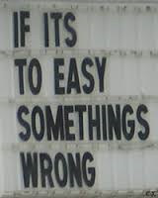

Slide 21
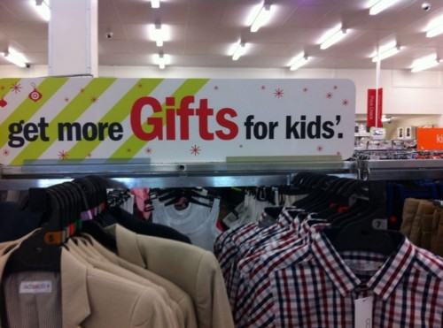

Slide 22
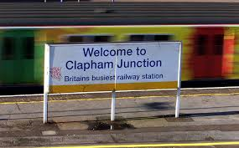

Slide 23
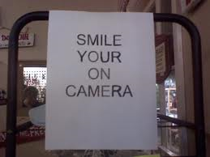

Slide 24
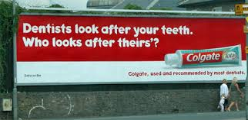

Slide 25
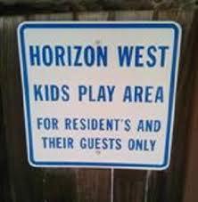

Slide 26
