Slide 1

Grammar Toolkit
Activeand passive voice
What is
active and passive voice?

Slide 2
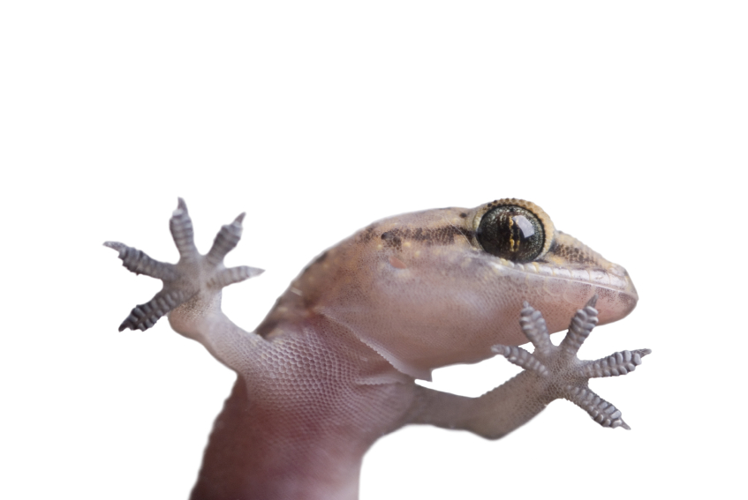
Grammar Toolkit
Activeand passive voice
Voice shows whether the subject
of a verb acts (active voice) or is acted
on (passive voice).
The gecko climbed the wall.
Active voice: the subject, the gecko, acts.
The wall was climbed by the gecko.
Passive voice: the subject, the wall, is acted on.
The passive voice has a form of the verb to be plus the past participle of the main verb.

Slide 3
Grammar Toolkit
Activeand passive voice
In which voice is the verb in each sentence?
The subject of the verb is red.
Jack and Jill climbed the hill.
The hill was climbed by Jack and Jill.
The fire department has been notified.
The fire destroyed the building in minutes.
The safe was blown up with explosives.
The project should have been completed
by your team.
active
passive
passive
active
passive
passive

Slide 4

Grammar Toolkit
Active and passive voice
Write mainly in the active voice because it
lets your reader know who or what is acting.
Gaston separates the eggs.
This emphasises who is acting.
However, use the passive voice to draw attention to a process (the action of the verb), rather than who or what does the process.
Which sentence are you most likely to find in a recipe book?
The eggs are separated by Gaston.
This emphasises what is being done and to what.
The eggs are separated.
The prepositional phrase can even disappear, to further emphasise the action.

Slide 5
Grammar Toolkit
Activeand passive voice
A verb’s voice shows whether the subject of the verb acts (active voice)
or is acted on (passive voice).
The passive voice has a form of the
verb to be plus the past participle of the main verb.
Write mainly in the active voice because it lets your reader know who or what
is acting.

Slide 6
Grammar Toolkit
Activeand passive voice
The End

